Slide 1
Software engineering in the wild – what makes awesome engineering ?

Slide 2


Intros
What we will build
Live example
Circuit breaker test
FRAMEWORKS
Reliability
engineering

Slide 3
Intros
What we will build
Live example
Circuit breaker test
URI uri = URI.create(bookstoreServer + "/recommended");
this.restTemplate.getForObject(uri, String.class)
Spring Boot ReST Client
(Reading Application)
REQUEST
Spring Boot ReST Server
(Book Store Application)
USES
RESPONSE
So much can go wrong…
Service failure
Latency
Cloud provider

Slide 4

Intros
What we will build
Live example
Circuit breaker test
Monitoring & Alerting
DATACENTER 1
Spring Boot ReST Client
(Stateless Reading Application)
Hystrix
(Circuit Breaker)
REQUEST
Spring Gateway
(API)
Spring Boot ReST Server
(Stateless Book Store Application)
Instance 1
RESPONSE
Eureka
(Service Discovery)
FIND
REGISTER
Eureka
(Service Discovery)
DATACENTER 2
REGISTER
FIND
Spring Boot ReST Client
(Stateless Reading Application)
Hystrix
(Circuit Breaker)
REQUEST
Spring Gateway
(API)
Spring Boot ReST Server
(Stateless Book Store Application)
Instance 2
RESPONSE
KEY
DATACENTER 3
Instance 3
Original Stateless services (from last slide)
Instances of services
Cassandra
Resiliency patterns
Simian Army

Slide 5

Intros
What we will build
Live example
Circuit breaker test
Spring Boot ReST Client
(Stateless Reading Application)
Hystrix
(Circuit Breaker)
REQUEST
Spring Boot ReST Server
(Stateless Book Store Application)
Circuit breakers maximise uptime if a service fails through fallback methods and fast failure – at least you are not sat waiting !
RESPONSE
How a circuit breaker works
fallback
fast failure
success
CLOSED
OPEN
HALF OPEN
open on failure of
rest server
check if rest server
working again
If fails stay open
If success close

Slide 6
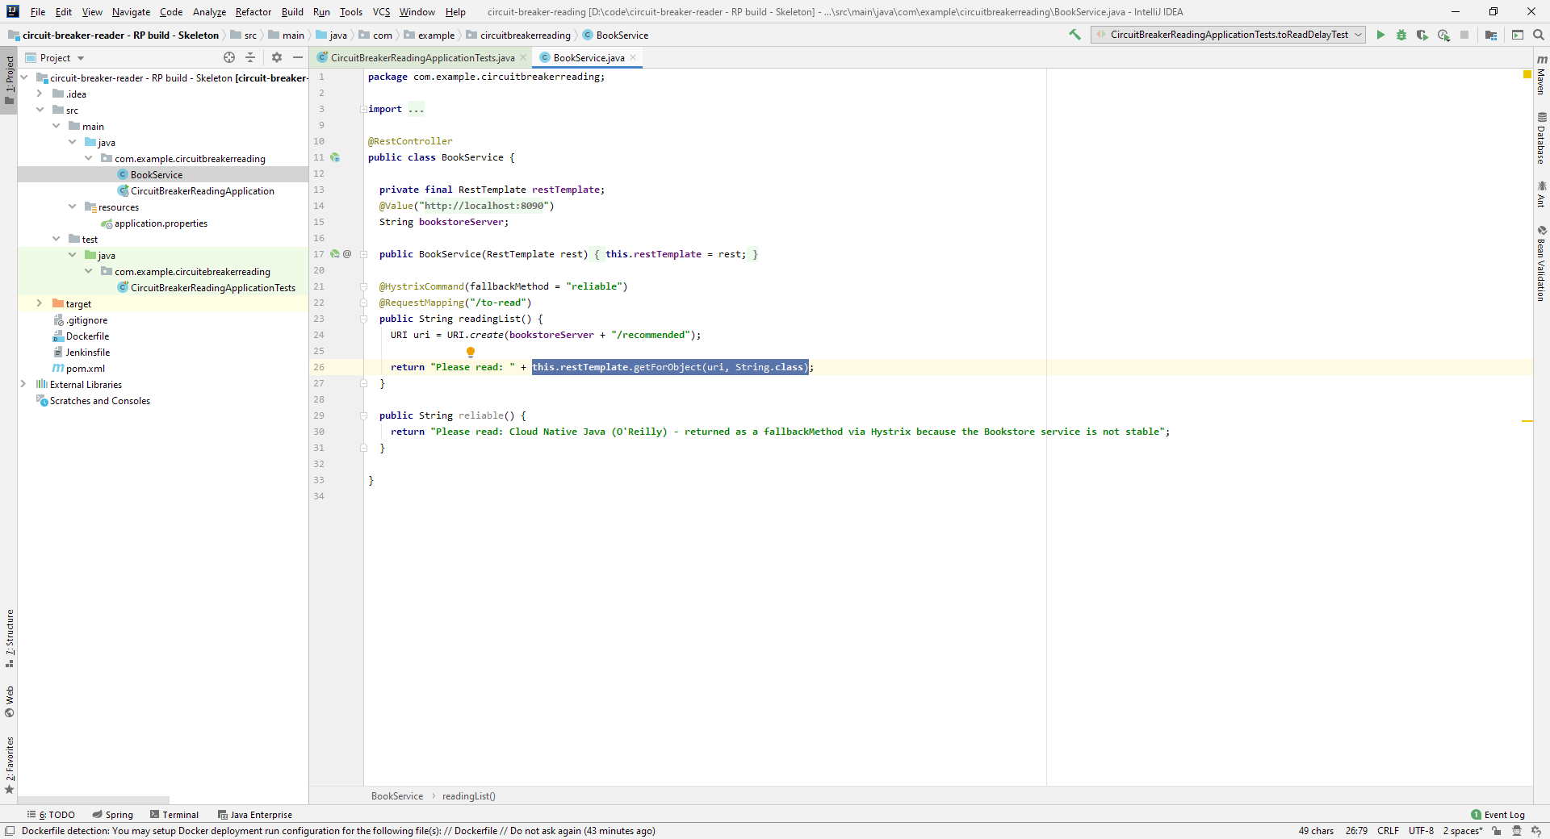
Intros
What we will build
Live example
Circuit breaker test

Slide 7
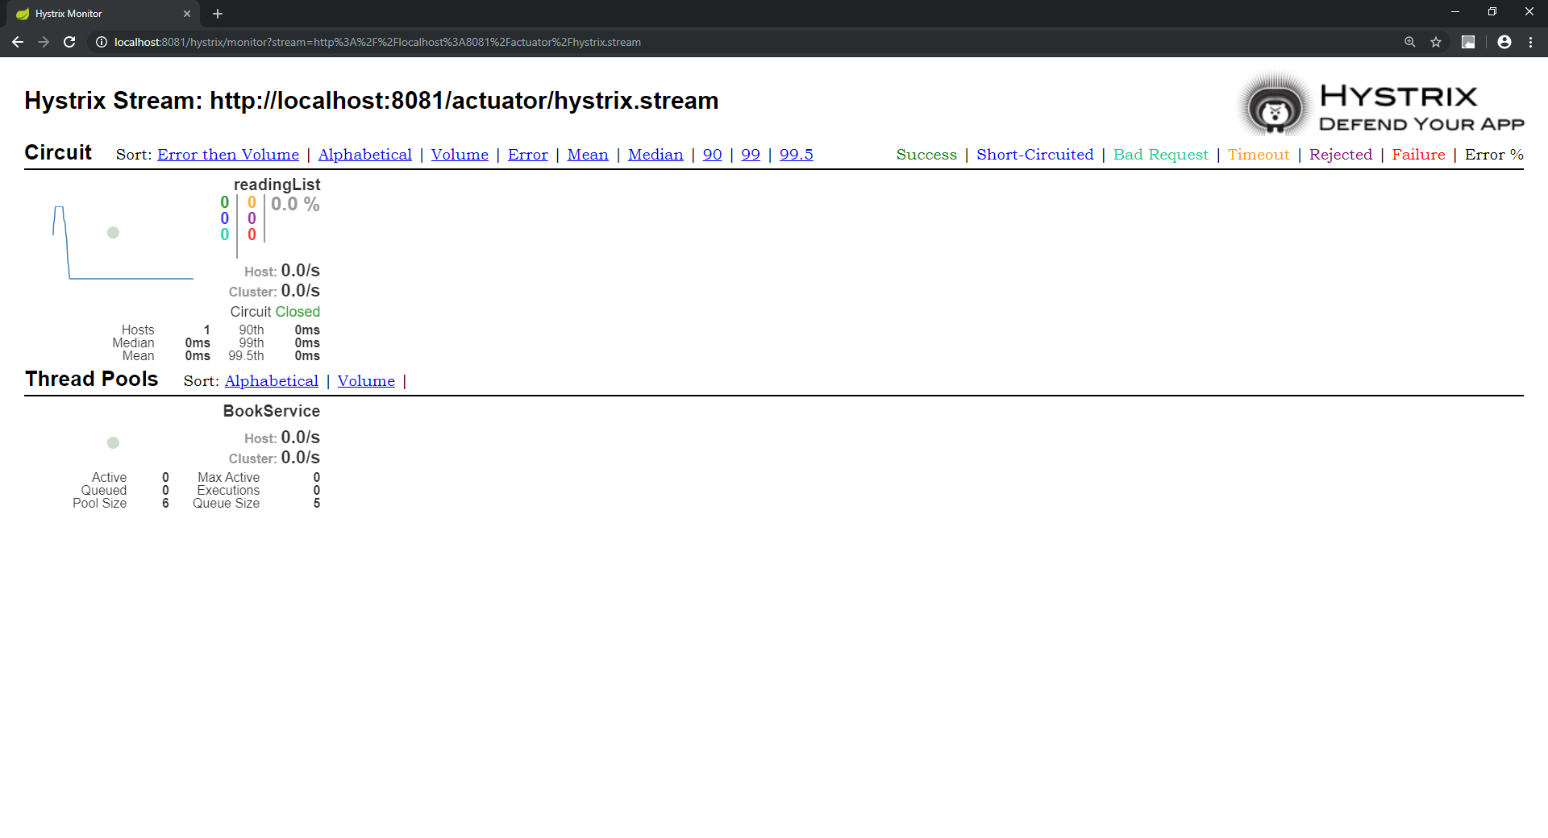
Intros
What we will build
Live example
Circuit breaker test

